Slide 1
True/False Test
For this test you will answer true/false questions about short stories. Each item on the test has two parts. In the first part, you will read a short story. Once you have read the story, press BUTTON 1 to indicate that you are done. In the second part, you will see a statement about the story. Press BUTTON 1 if you think the statement is TRUE and BUTTON 2 if you think the statement is FALSE. You will have a limited amount of time to read each story and answer each true/false judgment. If you run out of time, the test will automatically advance.
The test will begin in a moment

Slide 2
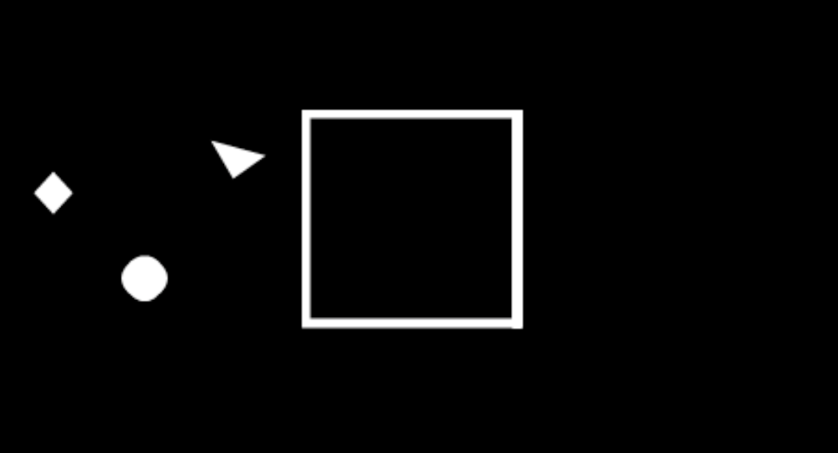
Visual Test – Part 1
For this test you will watch a series of brief videos featuring moving geometric shapes. Please watch each video carefully. Occasionally, you will see the video skip. When this happens, press BUTTON 1 to indicate that you noticed the skip.
The test will begin in a moment

Slide 3
Visual Test – Part 2
This is the second part of the visual test you did earlier. You will again watch the videos with the shapes. Before each video, you will receive instructions for how to watch the video.
For some videos, you will be asked to imagine the shapes are people interacting with each other. When these videos are over, you will be asked: “Are the people all friends?”
For other videos, you will be asked to imagine the shapes are bumper cars. When these videos are over, you will be asked: “Are the bumper cars all the same weight?”
Use BUTTON 1 for YES and BUTTON 2 for NO

Slide 4
Visual Test – Part 2
This is the second part of the visual test you did earlier. You will again watch the videos with the shapes. Before each video, you will receive instructions for how to watch the video.
For some videos, you will be asked to imagine the shapes are people interacting with each other. When these videos are over, you will be asked: “Are the people all friends?”
For other videos, you will be asked to imagine the shapes are bumper cars. When these videos are over, you will be asked: “Are the bumper cars all the same weight?”
Use BUTTON 1 for YES and BUTTON 2 for NO

Slide 5
Imagine the Shapes are
People

Slide 6
Imagine the Shapes are
Bumper Cars

Slide 7
Are they all friends?
1 2
Yes
No

Slide 8
Are they all the same weight?
1 2
Yes
No

